Slide 1
Technical Deep Dive: Migrating Applications to Microsoft Azure
<Presenter Name>

Slide 2
Agenda: Technical Deep Dive Migrating Applications to Azure
Module 1 – Contoso Application Challenges Module 2 – Cloud Computing Execution Models Module 3 – Migrating On-Premises Application to: Virtual Machines Cloud Services App Services Service Fabric Overview | Day 1
Module 4 - Migrating Application Database: SQL Server in IaaS Azure SQL Database Module 5 - Migrate Authentication to Azure Active Directory | Day 2
Audience: Architects, and IT Professionals
Notes:
Objective
Present the agenda and objective of the meeting
Notes:
This should be a two hour meeting
we are planning to have three demos in which we will walk you thourgh on the features we will present
Read the bullets

Slide 3
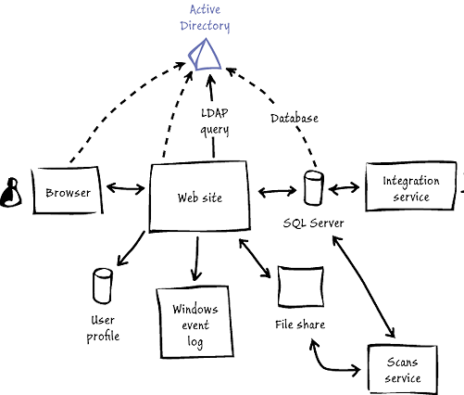
Scenario – Migrating an Web Application to Azure
Contoso Challenges
Contoso faces several challenges. Currently, deploying new on-premises applications takes too long, considering how quickly its business changes and how efficient its competitors are. The timeframe for acquiring, provisioning, and deploying even a simple application can be at least several weeks. No matter the application's complexity, requirements must be analyzed, procurement processes must be initiated, requests for proposals may need to be sent to vendors, networks must be configured, and so on. Contoso must be able to respond to its customers' demands more rapidly than the current procedures allow.
Notes:
Objective
Present the agenda and objective of the meeting
Notes:
This should be a two hour meeting
We are planning to have three demos in which we will walk you through on the features we will present
Read the bullet

Slide 4
Logistics for demo/hands-on labs
Download the student files for this course to a new folder on your computer named: C:\.
http://aka.ms/ptsip-migratingapps

